Slide 1
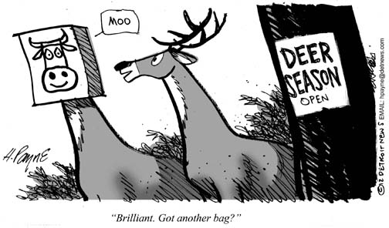
Deer Hunting Mathematical Model
By: Taylor Larrechea

Slide 2

Vague Scenario
A Parks and Wildlife department wishes to know how many deer tags to issue in one year to registered hunters. To answer this problem the Parks and Wildlife department needs to know an estimate for deer harvest off of knowing the number of registered hunters and total recreation days.

Slide 3
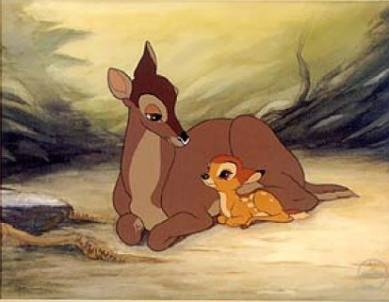

Problem Statement
This mathematical model aims to predict the total number of deer harvest in one year. This model is primarily dependent upon the total number of hunters $T_{h}$ and the total number of recreation days $T_{R}$.

Slide 4
Assumptions
As with every mathematical model, assumptions must first be made before the model is constructed.
There is no illegal hunting (Poaching) in the year specified.
The total number of registered hunters does not fluctuate throughout the year.
No additional recreation days or new units are added to the state in the specified year.

Slide 5
Strategy For Model construction
I first started fitting polynomials to total hunter dependent models first, and then moved on to total recreation days dependent models. At the end I did regression analysis on a two variable model for a combination of the two models.
Create total hunters dependent model
Create total recreation days dependent model
Regression analysis on two variable model

Slide 6
Data
The below table has the all of the data that I got off the Colorado Parks and Wildlife [1] page. The populations of the deer were estimates due to other assumptions that were made. The total harvest column is the column that I am aiming to model.
Year | Starting Population | Bucks | Does | Fawns | Remaining Population | Total Harvest | Total Rec Days | Total Hunters
2004 | 642643 | 33095 | 7904 | 744 | 600900 | 41743 | 270983 | 91646
2005 | 655115 | 32878 | 8217 | 570 | 613450 | 41665 | 394339 | 91757
2006 | 657994 | 33885 | 10617 | 732 | 612760 | 45234 | 440296 | 97286
2007 | 583796 | 32254 | 11845 | 927 | 538770 | 45026 | 435070 | 98283
2008 | 502312 | 25069 | 9771 | 712 | 466760 | 35552 | 395479 | 86245
2009 | 494442 | 24607 | 8751 | 564 | 460520 | 33922 | 364189 | 78536
2010 | 465164 | 25779 | 8302 | 687 | 430396 | 34768 | 360048 | 78603
2011 | 451167 | 24556 | 7991 | 670 | 417950 | 33217 | 338983 | 76445
2012 | 441096 | 24346 | 8187 | 553 | 408010 | 33086 | 332573 | 73705
2013 | 423601 | 24754 | 7633 | 554 | 390660 | 32941 | 338132 | 74233
Table 1: General Data

Slide 7


Best total Hunter Dependent Model
Model 1
$$T_{H}=−8.3∙{10}^{−10}∙{T_{h}}^{3}+2.3∙{10}^{−4}∙{T_{h}}^{2}−20.4∙T_{h}+621536$$
$$R^{2}=0.9758$$
$$T_{H}:Total Harvest$$
$$T_{h}:Total Hunters$$

Slide 8
Results from Third Degree Model
Model 1
This model did a good job in comparison to the actual harvest numbers. The other polynomials had much higher percent relative errors and residuals.
Year | Actual Harvest | 3rd Degree Model | Total Hunters | 3rd Degree PRE | 3rd Degree Residuals
2004 | 41743 | 41039 | 91646 | 1.69 | 704
2005 | 41665 | 41118 | 91757 | 1.31 | 547
2006 | 45234 | 44920 | 97286 | 0.69 | 314
2007 | 45026 | 45542 | 98283 | -1.15 | -516
2008 | 35552 | 37343 | 86245 | -5.04 | -1791
2009 | 33922 | 33681 | 78536 | 0.71 | 241
2010 | 34768 | 33699 | 78603 | 3.07 | 1069
2011 | 33217 | 33275 | 76445 | -0.17 | -58
2012 | 33086 | 33259 | 73705 | -0.52 | -173
2013 | 32941 | 33212 | 74233 | -0.82 | -271
Table 2: Third Degree Total Hunters Dependent Model Results
$$T_{H}=−8.3∙{10}^{−10}∙{T_{h}}^{3}+2.3∙{10}^{−4}∙{T_{h}}^{2}−20.4∙T_{h}+621536$$

Slide 9


Best Total Recreation Days Dependent Model
Model 2
$$T_{H}=−7.5∙{10}^{−12}∙{T_{R}}^{3}+9.38∙{10}^{−6}∙{T_{R}}^{2}−3.7∙T_{R}+514325$$
$$R^{2}=0.9114$$
$$T_{H}:Total Harvest$$
$$T_{h}:Total Recreation Days$$

Slide 10
Results from Third Degree Model
Model 2
This model is a little less accurate than the total hunters dependent model. Nonetheless, it still does a pretty decent job at predicting total harvest.
Year | Actual Harvest | 3rd Degree Model | Total Rec Days | 3rd Degree PRE | 3rd Degree Residuals
2004 | 41743 | 41755 | 270983 | -0.03 | -12
2005 | 41665 | 38454 | 394339 | 7.71 | 3211
2006 | 45234 | 45487 | 440296 | -0.56 | -253
2007 | 45026 | 44722 | 435070 | 0.67 | 304
2008 | 35552 | 38622 | 395479 | -8.64 | -3070
2009 | 33922 | 34678 | 364189 | -2.23 | -756
2010 | 34768 | 34296 | 360048 | 1.36 | 472
2011 | 33217 | 33087 | 338983 | 0.39 | 130
2012 | 33086 | 33003 | 332573 | 0.25 | 83
2013 | 32941 | 33067 | 338132 | -0.38 | -126
Table 3: Third Degree Total Recreation Days Dependent Model Results
$$T_{H}=−7.5∙{10}^{−12}∙{T_{R}}^{3}+9.38∙{10}^{−6}∙{T_{R}}^{2}−3.7∙T_{R}+514325$$

Slide 11


Deer Death Simulation
The below figures show the frequency distributions for the deer death simulation
of this model.
$$Fawns≈1.7\%$$
$$Does≈23.7\%$$
$$Bucks≈74.6\%$$
$0<Fawns<0.0178$
$$0.0178<Does<0.2544$$
$$0.2544<Bucks<1.0000$$

Slide 12
Model Selection/ Regression Analysis
The most accurate out the two models was model 1, or the total hunters dependent model. But because a single variable model isn’t very reliable for practical use, regression analysis was done on the table below.
Year | Actual Harvest | Total Hunters | Total Rec Days
2004 | 41743 | 91646 | 270983
2005 | 41665 | 91757 | 394339
2006 | 45234 | 97286 | 440296
2007 | 45026 | 98283 | 435070
2008 | 35552 | 86245 | 395479
2009 | 33922 | 78536 | 364189
2010 | 34768 | 78603 | 360048
2011 | 33217 | 76445 | 338983
2012 | 33086 | 73705 | 332573
2013 | 32941 | 74233 | 338132
Table 4: Data for Regression Analysis

Slide 13


Regression Analysis Continued
Model 3
Excel did its thing, and then I created an equation for this two variable model with the coefficients that the regression analysis gave.
$$T_{H}=0.535∙T_{h}−0.005∙T_{R}−5820$$
$$R^{2}=0.950$$
$$Adj. R^{2}=0.936$$
$$T_{H}:Total Harvest$$
$$T_{h}:Total Hunters$$
$$T_{R}:Total Recreation Days$$

Slide 14

Final Model Results
This model does a good job at predicting total harvest. Although this model has a smaller $R^{2}$ value than model 1, this model is the final model because it is the most practical for use.
Year | Actual Harvest | Final Model | Total Hunters | Total Rec Days | Final Model PRE | Final Model Residuals
2004 | 41743 | 41922 | 91646 | 270983 | -0.43 | -179
2005 | 41665 | 41374 | 91757 | 394339 | 0.70 | 291
2006 | 45234 | 44108 | 97286 | 440296 | 2.49 | 1126
2007 | 45026 | 44668 | 98283 | 435070 | 0.80 | 358
2008 | 35552 | 38417 | 86245 | 395479 | -8.06 | -2865
2009 | 33922 | 34442 | 78536 | 364189 | -1.53 | -520
2010 | 34768 | 34499 | 78603 | 360048 | 0.77 | 269
2011 | 33217 | 33447 | 76445 | 338983 | -0.69 | -230
2012 | 33086 | 32011 | 73705 | 332573 | 3.25 | 1075
2013 | 32941 | 32266 | 74233 | 338132 | 2.05 | 675
Table 5: Final Model Results
$$T_{H}=0.535∙T_{h}−0.005∙T_{R}−5820$$

Slide 15
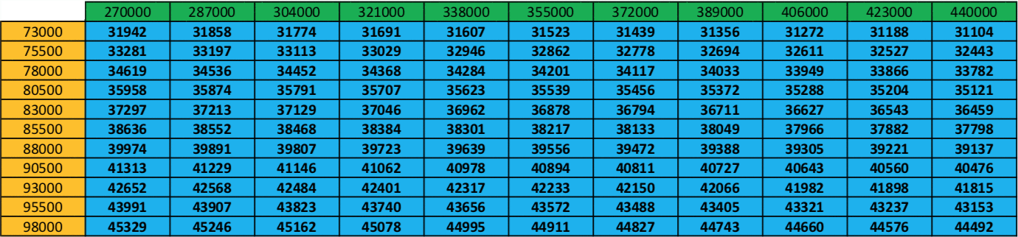
Final Model
Table 6 is the final model for estimating deer harvest. It is important to note that the values in orange are number of total hunters, where the values in green are number of total recreation days, and the results in blue are total deer harvest. These values are all scaled for one year estimates.
Table 6: Final Model Implementation

Slide 16
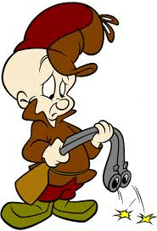
Conclusion
To recap, I made two separate models that were dependent upon separate variables. Although the best models did a good job at predicting total harvest, I concluded that it was better to have a model that had two variables in it for this type of problem statement. Hunting usually relies on a lot more than total hunters and total recreation days, but for this model they deemed themselves as adequate variables. The only other variable that may be useful is the total allowed square footage in one season, but no where online had this data.

Slide 17
References
[1]-Wildlife, Colorado Parks and. Colorado Parks and Wildlife. 1 January 2018. 28 April 2018. <http://cpw.state.co.us/thingstodo/Pages/Statistics-Deer.aspx>.

